Slide 1
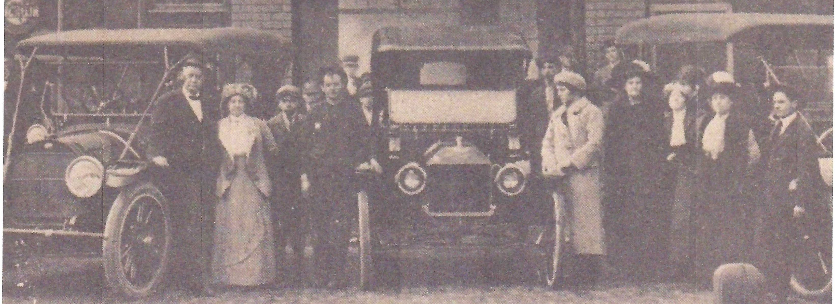
SEK ALLIANCE 2022 PROJECT
DAY TRIPPIN’ DRIVING TOURS
SEK MUSEUMS & MORE

Slide 2
DEFINE A DRIVING TOUR
MUSEUM PERSONNEL SERVES AS GUIDES FOR VISITORS TO LOCAL SITES
DESIGNATED DATE
DESIGNATED TIME
RESERVATIONS REQUIRED
FEE CHARGED
PARTICIPANTS FURNISH THEIR OWN TRANSPORTATION TO SITES
ATTENDANCE MAY BE LIMITED BASED ON THE SITES CAPACITY
DRIVING TOUR FEATURES THE SPONSORING MUSEUM
LOCAL ATTRACTIONS – HOMES/ CHURCHES/BUSINESSES/BUILDINGS
ARE ADDED TO THE TOUR FOR VARIETY

Slide 3
BENEFITS TO THE MUSEUM - COMMUNITY
MUSEUM BENEFITS
INCREASES ATTENDANCE AT MUSEUM
RAISES AWARENESS/EXCITEMENT OF MUSEUM’S ACTIVITIES
FUND RAISER – INCOME PRODUCER
COMMUNITY BENEFITS
TOURISM DOLLARS INTO THE COMMUNITY
GAS PURCHASES
RESTAURANT/FOOD PURCHASES
LOCAL BUSINESS HAS INCREASED TRADE
OVERNIGHT HOTEL STAYS

Slide 4
SEK ALLIANCE ROLE IN PROCESS
PHASE ONE - EDUCATIONAL SESSION ON BUILDING A DRIVING TOUR
STANDARDIZED GUIDELINES
SUGGESTED TOURIST ATTRACTIONS PRO’S & CONS
PUBLICITY ON SEK FACEBOOK SITE AND OTHER ALLIANCE MUSEUM SITES
PHASE TWO – INDIVIDUAL MUSEUMS DEVELOPS THEIR LOCAL TOUR CONTENT
PHASE THREE – PARTNER WITH ANOTHER SEK ALLIANCE MUSEUM
PHASE FOUR – DEVELOP SEK ALLIANCE MEMBER TOURS

Slide 5
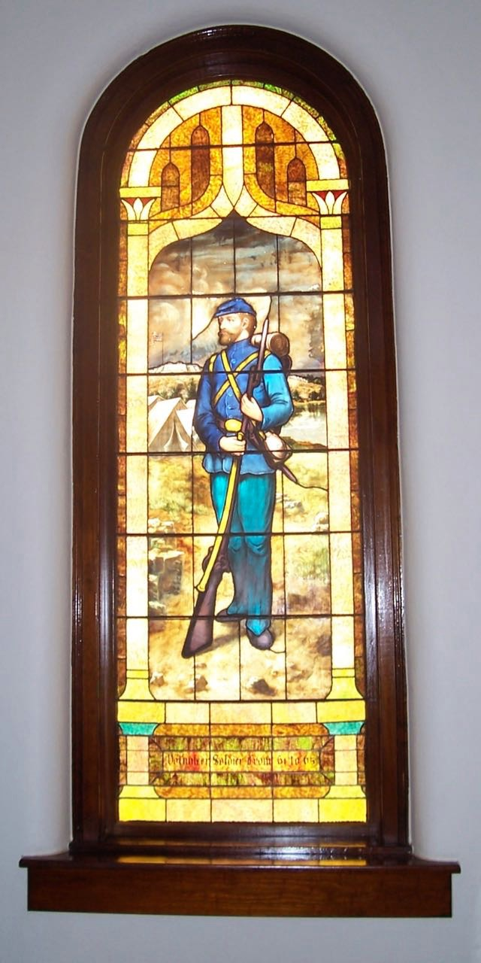
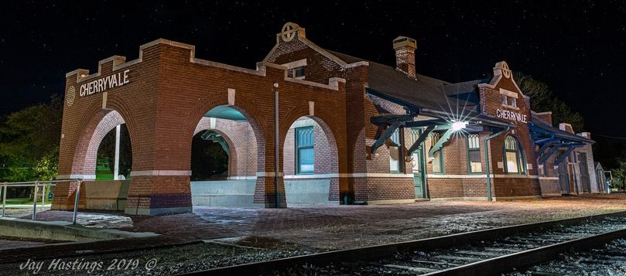
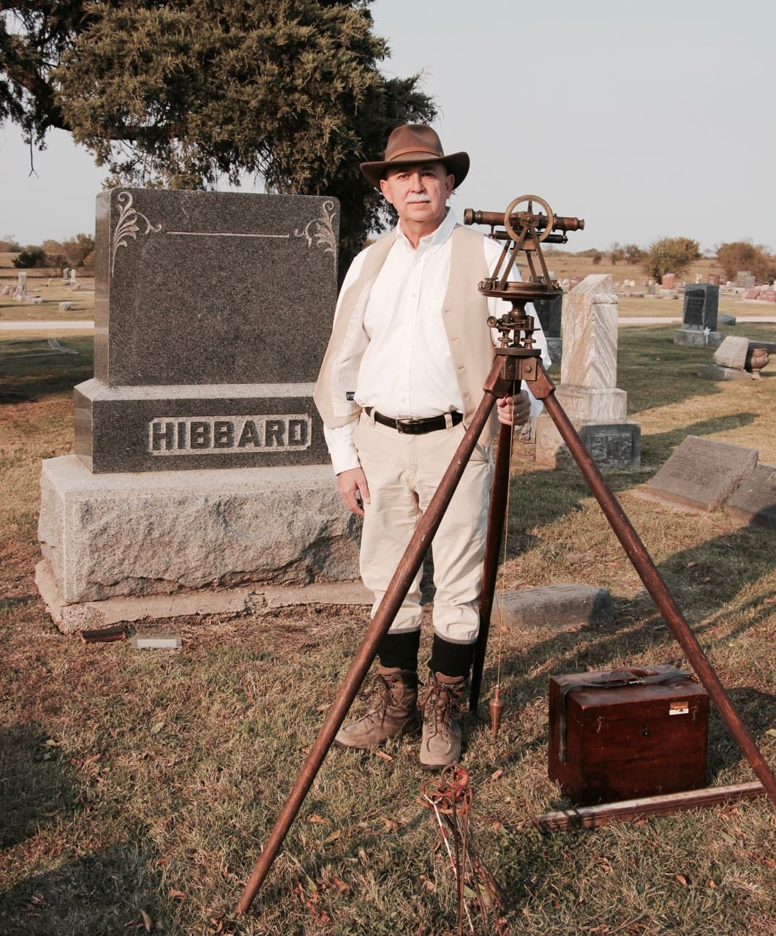
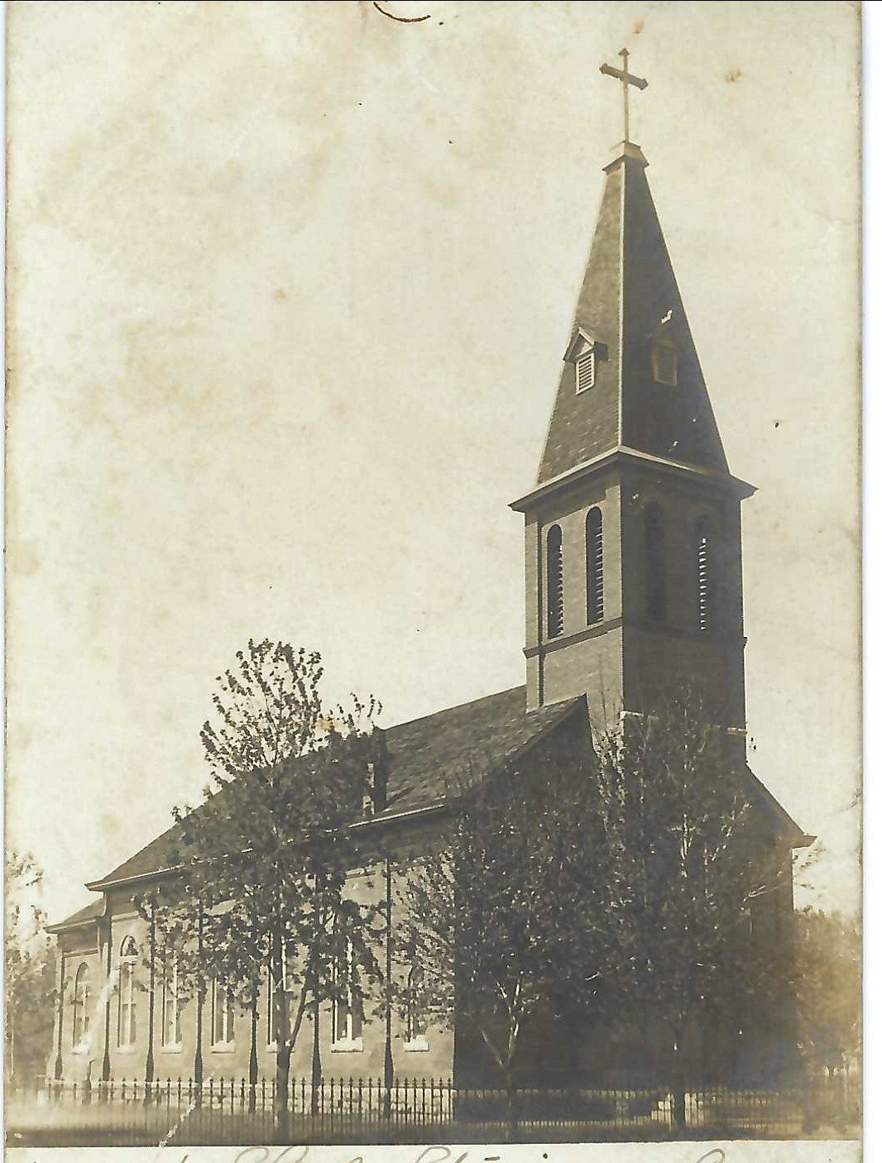
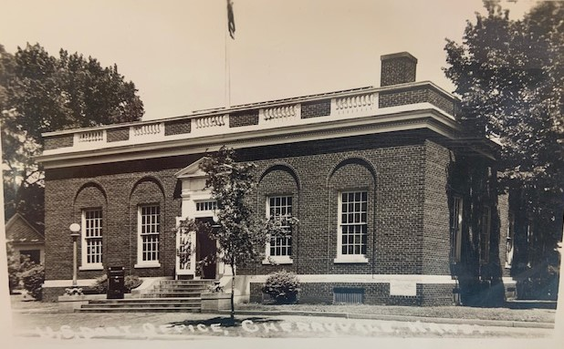
PLANNING A DRIVING TOUR

Slide 6
ARE YOU INTERESTED?
IN TRAINING SESSIONS TO LEARN HOW TO DEVELOP A DRIVING TOUR
IN BEING A PARTNERNING MUSEUM ON TOURS
IN SEK ALLIANCE MUSEUM MEMBERS DRIVING TOURS

